Slide 1

SPOTIFY MUSIC DATA ANALYSIS
submitted by~
K. Sreevalli Sai Keerthi
D. Vaisalya
D. Siva Rama Krishna
G. Ajay Kumar
S.V N S K CH Vivek

Slide 2
CONTENTS
Abstract
Introduction
System Requirements
Architecture
Uses of data analysis library
Advantages
Conclusion

Slide 3
ABSTRACT
This project presents a detailed analysis of Spotify music data using Python and key libraries like Pandas, NumPy, Seaborn, and Matplotlib in the Jupyter Notebook environment. The dataset includes various musical attributes such as danceability, energy, tempo, popularity, and genre.
The main objective is to discover patterns and trends that influence a song's popularity and explore how these features differ across genres. This analysis highlights the importance of data in decision-making and prediction while helping develop essential technical skills and offering valuable insights into the music industry.

Slide 4
INTRODUCTION
In today’s fast-changing world, data analysis has become very important in many areas like business, research, and even weather forecasting. This project shows how useful data can be in making decisions, supporting research, and predicting trends.
In this project, we focused on Spotify music data, using Python to find useful information from it. Spotify is a popular music platform known for features like sharing songs easily and showing synchronized lyrics.
Using Python libraries and functions, I explored and worked with the data. From cleaning the data to making graphs and charts, this project covers all the main steps of data analysis. Working in Jupyter Notebook made it easy to interact with the data and find interesting patterns.

Slide 5
SYSTEM REQUIREMENTS
Operating System:
The analysis can be performed on Windows, macOS, or Linux systems.
Python: Python 3.x is required to run the analysis smoothly.
Libraries: Pandas, Numpy, Matplotlib, Seaborn
Pandas – for data manipulation
pip install pandas

Slide 6
SYSTEM REQUIREMENTS
NumPy – for numerical operations
pip install numpy
Matplotlib – for data visualization
pip install matplotlib
Seaborn – for advanced graphs
pip install seaborn
IDE: Jupyter Notebook

Slide 7
ARCHITECTURE
1. Data Collection
Import the Spotify dataset (usually in .csv format).
The data contains features like danceability, tempo, energy, popularity, etc.
2. Data Preprocessing
Clean the data: handle missing values, duplicates, or inconsistencies.
Convert data types and prepare the data for analysis.
3. Data Analysis
Use Pandas and NumPy to analyze trends, averages, correlations.
Identify which features influence song popularity.

Slide 8
ARCHITECTURE
4. Data Visualization
Use Matplotlib and Seaborn to create:
Bar charts
Heatmaps
Histograms
Scatter plots
These visuals help in understanding patterns clearly.
5. Insights & Conclusion
Summarize key findings.
Understand how musical features relate to each other and influence success.

Slide 9
IMPORTING DATASET:
The project begins with data collection, where the Spotify music dataset is obtained from reliable repositories or research databases. The dataset is then loaded into the Python environment using the Pandas library, creating a structured DataFrame for efficient data handling.
import numpy as np
import pandas as pd
import matplotlib.pyplot as plt
import seaborn as sns
sp = pd.read_csv('spotify_dataset.csv’)
sp

Slide 10
DATA EXPLORATION:
After importing the dataset, the next step is to explore the structure and content of the data. This step helps in understanding the features (columns), types of data, and identifying any initial patterns Using Pandas functions
sp.shape
sp.columns
(114000, 21)
Index(['Unnamed: 0', 'track_id', 'artists', 'album_name', 'track_name', 'popularity', 'duration_ms', 'explicit', 'danceability', 'energy', 'key', 'loudness', 'mode', 'speechiness', 'acousticness', 'instrumentalness', 'liveness', 'valence', 'tempo', 'time_signature', 'track_genre'], dtye='object')

Slide 11
DATA GROUPING:
Data Grouping is the process of organizing data into groups based on the values of one or more columns.
In Spotify data analysis, grouping helps you:
Analyze trends (e.g., average song duration per year)
Summarize data (e.g., total songs per artist)
#Average Duration per Year
duration_by_year = spotify.groupby('year')['duration_ms'].mean()
duration_by_year
year
2000 210154.23
2001 204320.19
2002 202897.87
Name: duration_ms,
dtype: float64
#Add Total Score Column (Energy + Danceability):
spotify['total_vibe'] = spotify['energy'] +spotify['danceability']
spotify['total_vibe'].sum()
120309.45

Slide 12
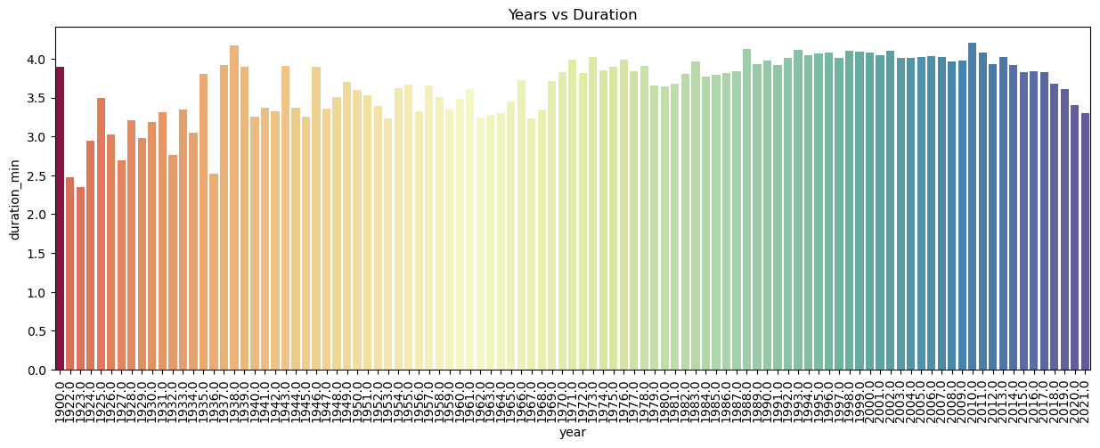
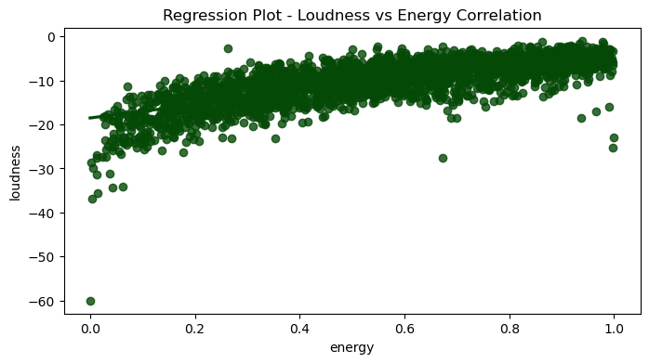
DATA VISUALISATION:
Data Visualization is the process of representing data in the form of graphs, charts, and plots. It helps in understanding complex data more easily by converting it into visual formats.
Identifying patterns and trends in music data (e.g., duration or popularity over time)
Comparing different categories (like top artists or genres)
Exploring relationships between features (like energy and loudness)
Presenting insights in a clear and attractive way

Slide 13
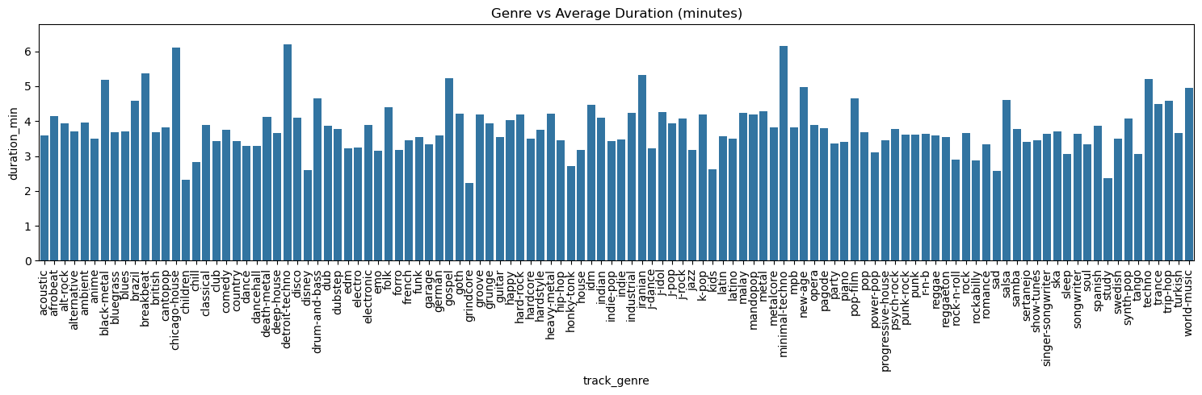
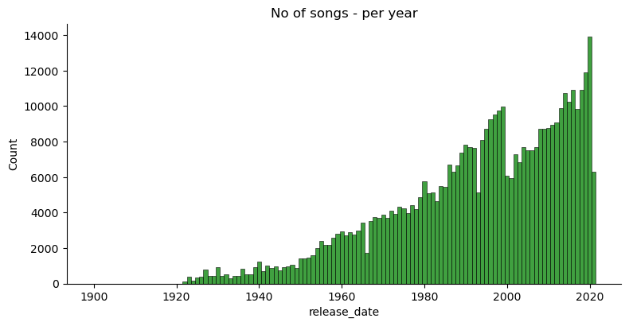
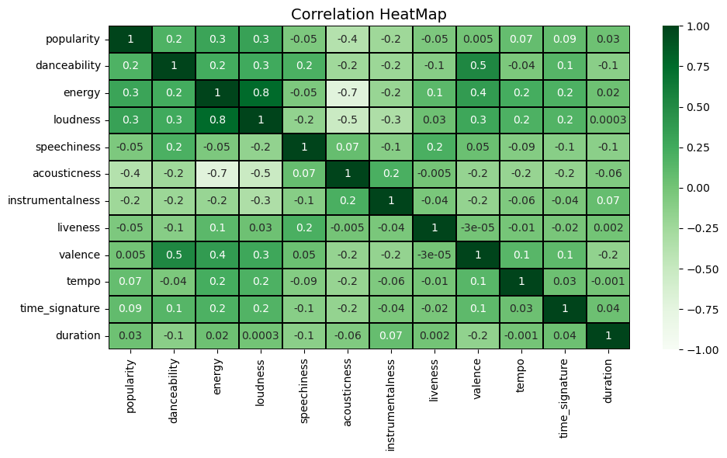
DATA VISUALISATION:

Slide 14
USES OF DATA ANALYSIS LIBRARY
PANDAS
Data Handling and Cleaning: Pandas was used to load the Spotify dataset, handle missing values, remove duplicates, and filter or group data for meaningful insights.
Grouping and Aggregation: Grouping functions helped analyze trends like average song duration per year or number of songs per artist.
Data Transformation: Columns were renamed, date formats were converted, and irrelevant data was removed to prepare for visualization.
MATPLOTLIB
Basic Data Visualization: Matplotlib helped create line charts, bar plots, and histograms to show trends in song popularity, artist activity, and yearly stats.

Slide 15
USES OF DATA ANALYSIS LIBRARY
SEABORN
Advanced Visualization: Seaborn was used to create visually rich and informative plots like correlation heatmaps, KDE plots, and boxplots.
Trend Analysis: Line plots and bar charts created using Seaborn helped identify trends in music features over time (e.g., energy, danceability).
Category Insights: Seaborn made it easy to compare features like genres, popularity, and artist trends across categories.

Slide 16
Advantages of Spotify Music Data Analysis
1. Understanding Music Trends
Analyzing Spotify data helps identify how music preferences have changed over time — for example, how average song duration or popularity has shifted year by year.
2. Artist and Genre Insights
It helps discover the most active or popular artists and genres by measuring song counts, average popularity, and performance over time.
3. Feature Optimization
By analyzing which features are common in popular songs (like tempo, loudness, danceability), new songs can be composed to match those characteristics.
8. Predicting Viral Hits
Using machine learning (optional extension), this data can be used to predict which upcoming songs might go viral based on past popularity patterns.

Slide 17
CONCLUSION
The Spotify Music Data Analysis project helped uncover useful patterns and trends in modern music using real-world data. With the help of Python libraries like Pandas, Matplotlib, and Seaborn, the dataset was cleaned, analyzed, and visualized effectively.
Through this analysis, we were able to:
Observe how song features like duration and popularity changed over the years
Identify the characteristics of popular songs such as energy, danceability, and loudness
Visualize correlations between different music attributes
Understand how data can be used to improve music recommendations and user experience
This project shows how powerful and meaningful insights can be extracted from raw data. It also highlights the importance of data analytics in shaping the future of music platforms like Spotify.

Slide 18
Thank you

